Slide 1


Optimizing synchronization primitives in Wine
Zeb Figura
Linux Plumbers Conference 2023

Slide 2
About me
Wine developer for ~6 years
Wine work on multimedia, 3D, Win16, sockets, hardware, kernel…
One kernel patch
Employed by CodeWeavers
  We do consulting and porting using Wine

Slide 3
Wine’s “kernel”
Wine userspace
“user”
ntdll.dll
wineserver
“kernel”
MM
file I/O
sockets
signals
futex
sync
IPC (pipes)
windows
registry
handles
Host kernel (Linux)

Slide 4
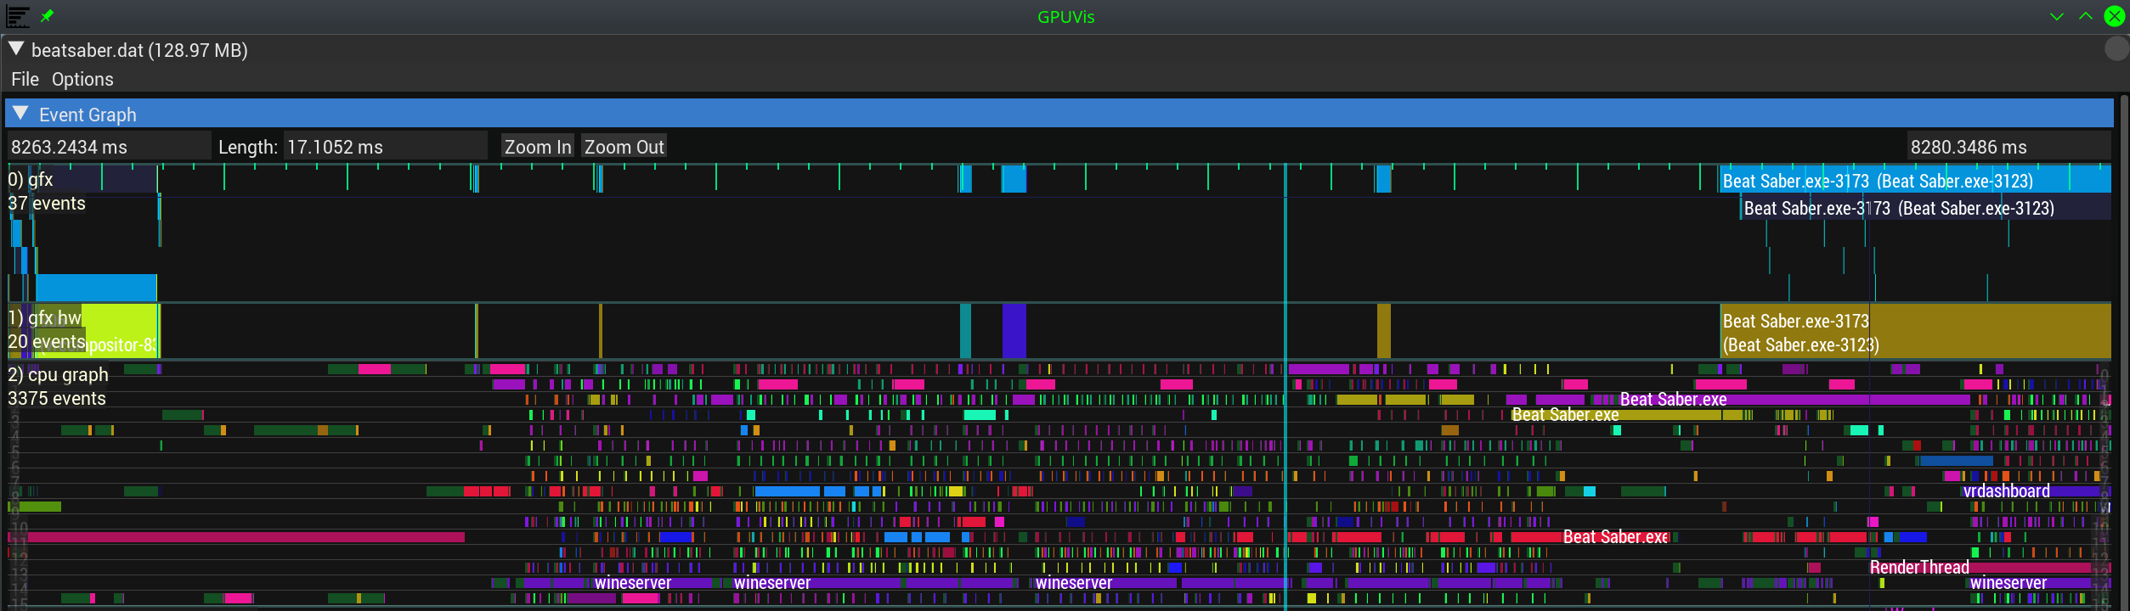

Slide 5
What are handles?

Slide 6
What are handles?
A handle is a file descriptor
  But need not be a file
Handles can have names
  \??\some\path
Handles have access flags
  Objects can have ACLs
Handles are per-process
  But they can be shared across processes
Many different types:
  Event
  Mutex
  Semaphore
  Timer
  Thread
  Process
  File
  Pipe
  Socket
  Window message queue

Slide 7
The easy parts
Events: NtSetEvent(), NtResetEvent()
Mutexes: NtReleaseMutant()
Semaphores: NtReleaseSemaphore()
NtWaitForMultipleObjects()
  It’s like poll(2)
  ...but it consumes state

Slide 8
The hard parts
Events: NtPulseEvent()
Mutexes: abandonment (think EOWNERDEAD)
Semaphores: ☺
NtWaitForMultipleObjects()
  It can wait on “all”
  It can wait on an “alert” (Windows version of SIGIO)

Slide 9
Is there a user space solution?

Slide 10
esync
Each object is backed by an eventfd(2)
Extra state in shared memory
Vectored wait via poll(2)
Easy | Hard
✓ NtSetEvent() ✓ NtResetEvent() ✓ NtReleaseMutant() ✓ NtReleaseSemaphore() ✓ NtWaitForMultipleObjects() | ✗ NtPulseEvent() ✓ Abandoned mutexes ✗ Wait-for-all ✓ Alertable wait

Slide 11
fsync
Each object is backed by a futex word in shared memory
Extra state in shared memory
Vectored wait via futex_waitv(2)
Easy | Hard
✓ NtSetEvent() ✓ NtResetEvent() ✓ NtReleaseMutant() ✓ NtReleaseSemaphore() ✓ NtWaitForMultipleObjects() | ✗ NtPulseEvent() ✓ Abandoned mutexes ✗ Wait-for-all ✓ Alertable wait

Slide 12
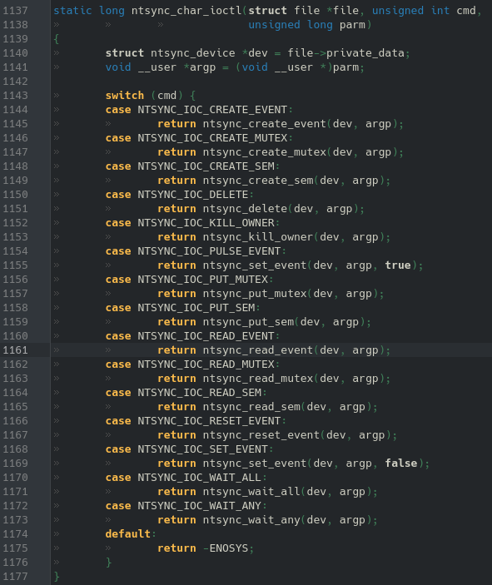

Slide 13
The hard parts - revisited
Events: NtPulseEvent()
Mutexes: abandonment (think EOWNERDEAD)
Semaphores: ☺
NtWaitForMultipleObjects()
  It can wait on “all”
  It can wait on an “alert” (Windows version of SIGIO)

Slide 14
Handles revisited
A handle is a file descriptor
  But need not be a file
Handles can have names
  \??\some\path
Handles can be dup’d
  NtDuplicateObject
Handles have access flags
  Objects can have ACLs
Many different types:
  Event
  Mutex
  Semaphore
  Timer
  Thread
  Process
  File
  Pipe
  Socket
  Window message queue

Slide 15
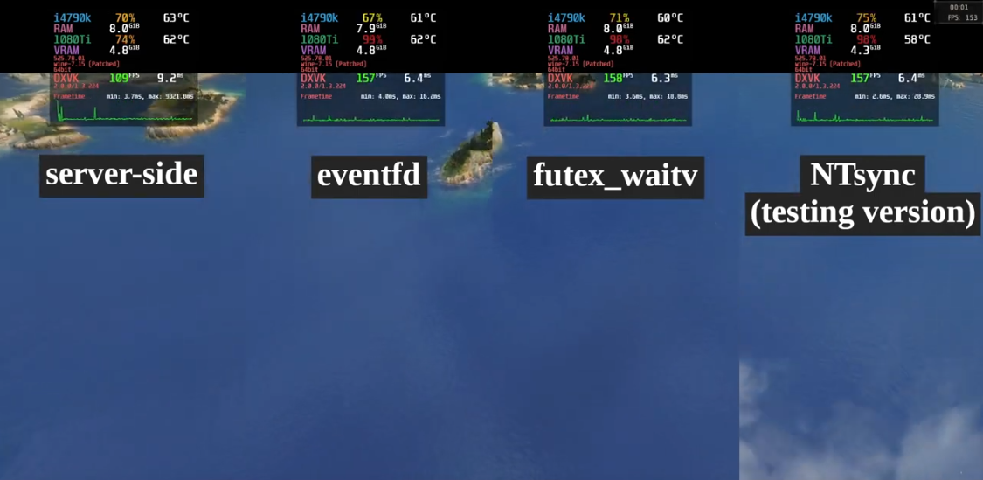

Slide 16
More benchmarks
 | server | ntsync | improvement
Call of Juarez | 99.8 | 224.1 | 124.55%
Dirt 3 | 110.6 | 860.7 | 678.21%
Forza Horizon 5 | 108 | 160 | 48.15%
Total War Saga: Troy | 109 | 146 | 33.94%
Metro 2033 | 164.4 | 199.2 | 21.17%
The Crew | 26 | 51 | 96.15%
Resident Evil 2 | 26 | 77 | 196.15%
Anger Foot demo | 69 | 99 | 43.48%
Lara Croft and the Temple of Osiris | 141 | 326 | 131.21%
Tiny Tina’s Wonderlands | 130 | 360 | 176.92%
Thanks to Dmitry Skvortsov, FuzzyQuills, OnMars

Slide 17
Solutions?
Submit the driver upstream?
  May be the best way to match Windows performance...
Extend existing APIs?
  But NT is ugly...
Half-baked idea: fast user-space RPC?
  With a single context switch?
    This could have interesting use cases elsewhere in Wine...
Something else?

Slide 18

More information
https://www.winehq.org/
https://repo.or.cz/linux/zf.git/shortlog/refs/heads/ntsync4
https://repo.or.cz/wine/zf.git/shortlog/refs/heads/ntsync4
zfigura@codeweavers.com

